Slide 1

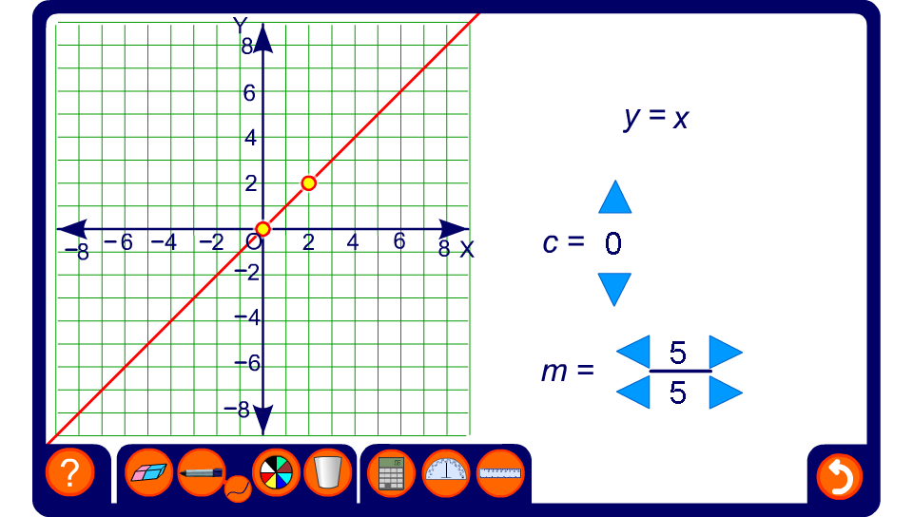


Investigating linear graphs
Notes:
Use this activity to explore the effect of changing the value of the coefficient of x (m) and the value of the number that is added on (c).
Establish that m is the gradient of the line and c is the intercept on the y-axis.

